Slide 1
EEE 452: Engineering Economics and Management
Lec 05: Role of Technology Life Cycle and Innovation Diffusion Pattern on Management Decision Making
Faculty: Dr. M. Rokonuzzaman
Zaman.rokon@yahoo.com
Ref: Strategic Management of Technology and Innovation
R. A. Burgelman, M.A. Maidique, and S.C. Wheelwright

Slide 2
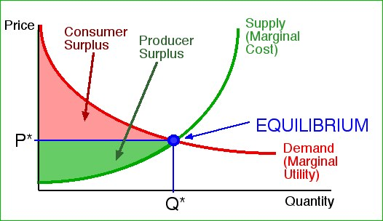
Focus area

Slide 3
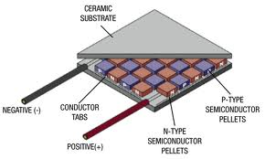
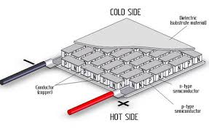
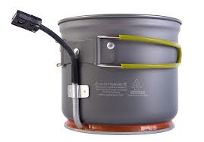

What is it?
What do consumer and producer surplus mean in this technology based innovation?

Slide 4
Key questions
Where is economics?
What is its future potential?
What are key technology performance parameters?
What are key success factors?
What are application areas?
Who are your different categories of customers?
What would be your technology/product/business strategy to build large business out of it in Bangladesh?

Slide 5
You have to take a series of management decisions in developing business around this potential?
Should it be a profession for an engineer?

Slide 6
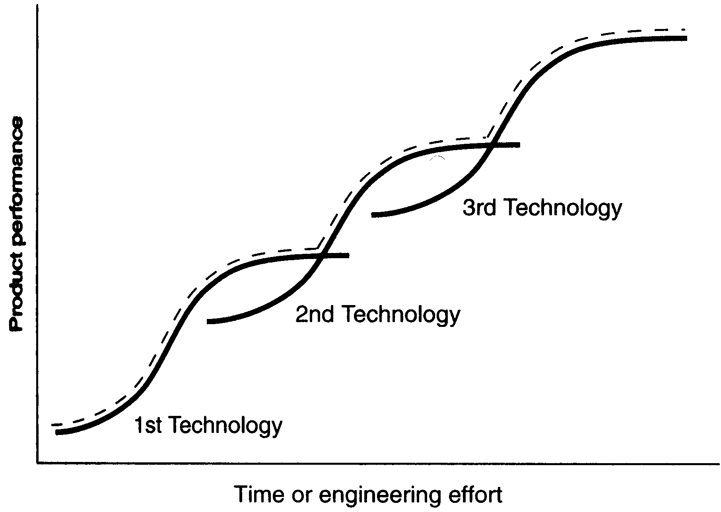
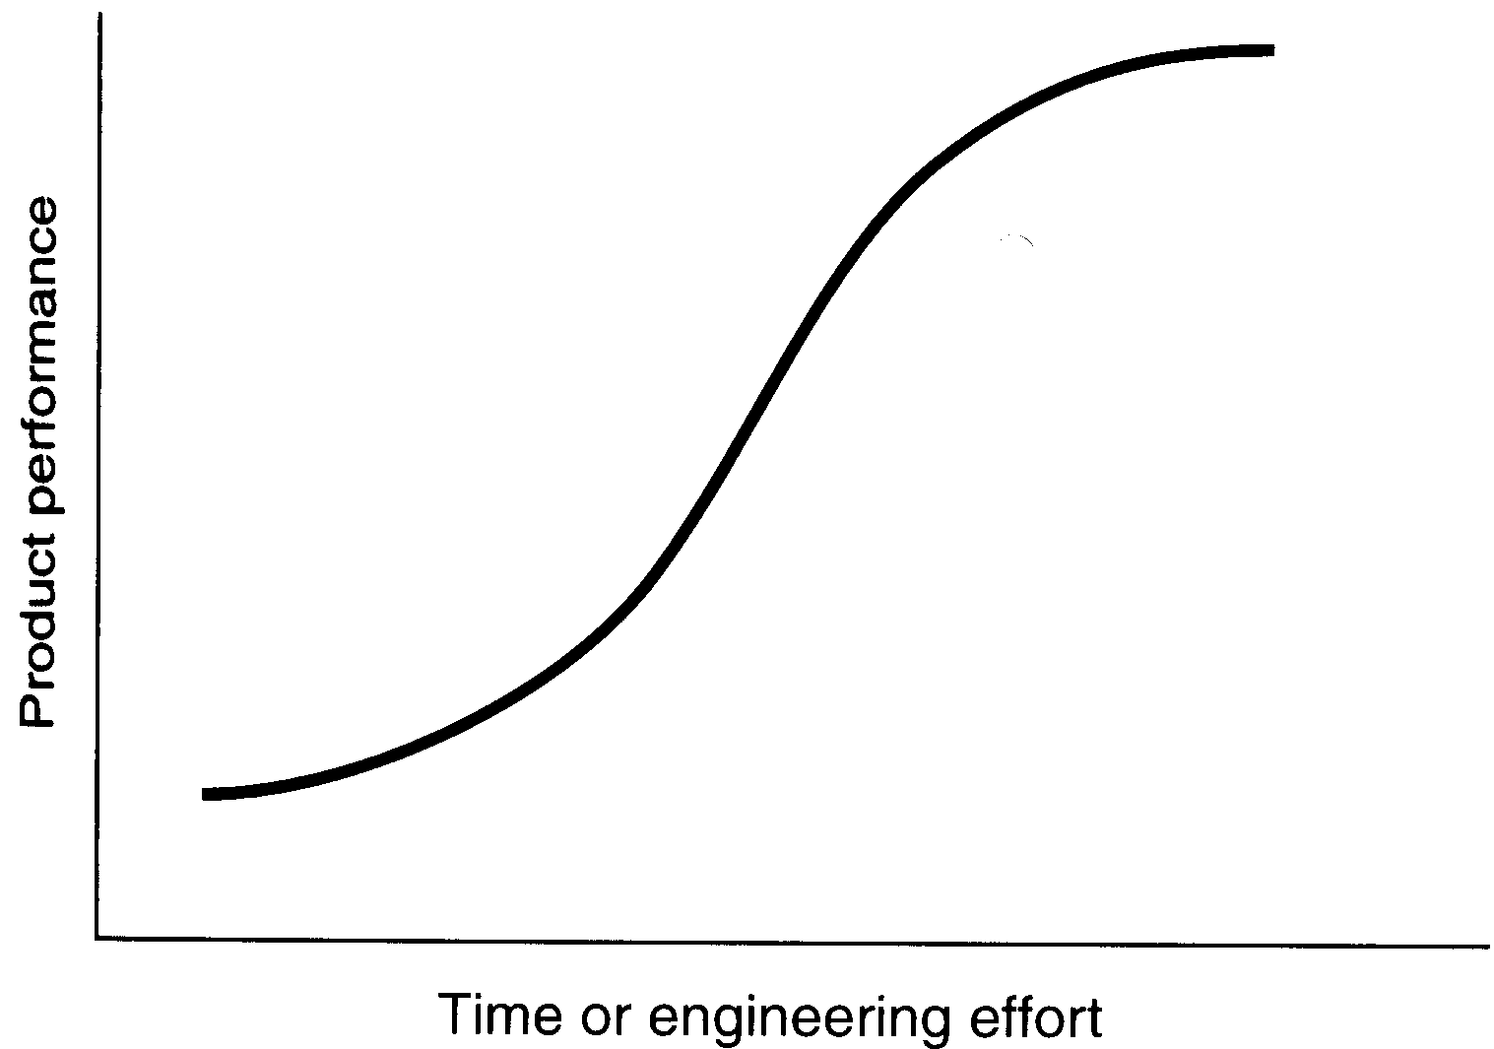
What is “S-Curve”?
The uses of S-curve at the industry level :
The description of the magnitude of improvement
The prescriptive S-Curve theory
Product performance results from:
Component technology
Architectural design
S-curve can provide convincing explanations of why alternative technologies have made substantial inroads against currently dominant technology?

Slide 7
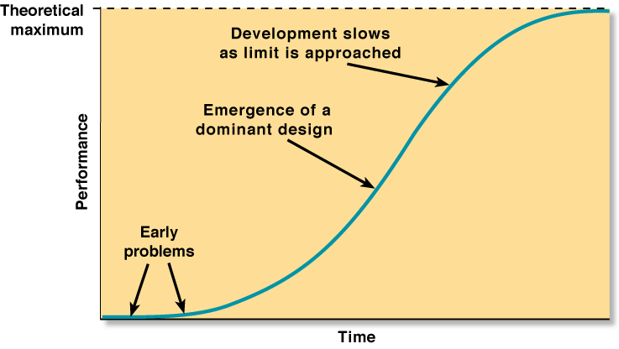
The Technology Life Cycle

Slide 8
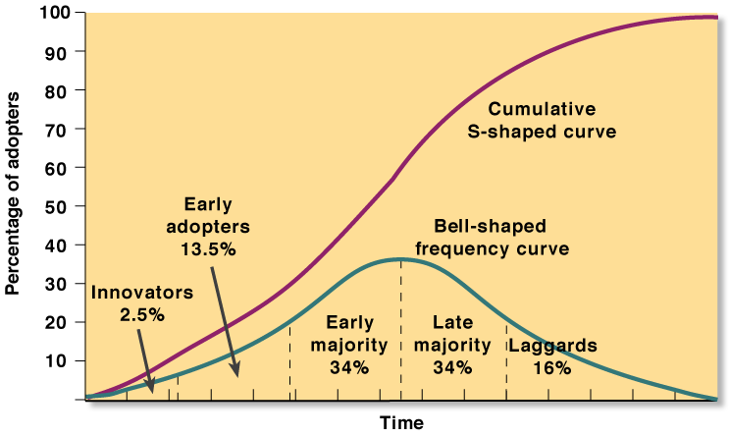
Technology Dissemination Pattern and Adopter Categories

Slide 9
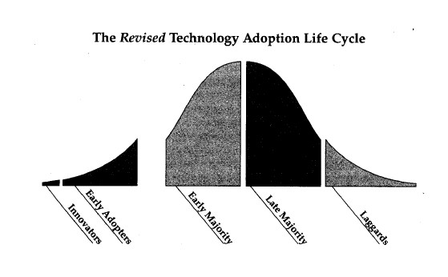

Slide 10
Early Adopters are the rare breed of visionaries "who have the insight to match an emerging technology to a strategic opportunity,… driven by a 'dream'.
The core dream is a business goal, not a technology goal, and it involves taking a quantum leap forward in how business is conducted in their industry or by their customers… Visionaries drive the high-tech industry because they see the potential for an 'order-of-magnitude' return on investment and willingly take high risks to pursue that goal.
They will work with vendors who have little or not funding… As a buying group, visionaries are easy to sell but very hard to please… because they are buying a dream…They want to start out with a pilot project, which makes sense because they are 'going where no man has gone before' and you are going with them.
This is followed by more project work, conducted in phases with milestones, and the like."

Slide 11
"You can succeed with the visionaries, and you can thereby get a reputation for being a high flyer with a hot product, but that is not ultimately where the dollars are. Instead, those funds are in the hands of more prudent souls who do not want to be pioneers"

Slide 12
The Early Majority are pragmatists… "they care about the company they are buying from, the quality of the product they are buying, the infrastructure of supporting products and system interfaces, and the reliability of the service they are going to get… Pragamatists tend to be 'vertically' oriented, meaning that they communicate more with others like themselves within their own industry than do technology enthusiasts and early adopters… It is very difficult to break into a new industry selling to pragmatists.
References and relationships are very important…Pragmatists won't buy from you until you are established, yet you can't get established until they buy from you…

Slide 13
"On the other hand, once a startup has earned its spurs with the pragmatist buyers within a given vertical market, they tend to be very loyal to it, and even go out of their way to help it succeed. When this happens, the cost of sales goes way down, and the leverage on incremental R&D to support any given customer goes way up. That's one of the reasons pragmatists make such a great market…
"They like to see competition… Pragmatists want to buy from proven market leaders because they know third parties will design supporting products around a market-leading products… aftermarket…

Slide 14
"Overall, to market to pragmatists, you must be patient. You need to be conversant with the issues that dominate their particular business. You need to show up at the industry-specific conferences and trade shows they attend. You need to be mentioned in articles that run in magazines they read. You need to be installed in other companies in their industry. You need to have developed applications that are specific to their industry. You need to have partnerships and alliances with the other vendors who serve their industry. You need to have earned a reputation for quality and service.

Slide 15
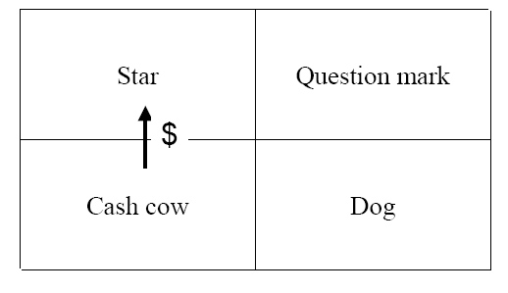
The Position on S-curve Corresponding to BCG
HIGH
Market Share
LOW
Product performance
Growth
?
?
Time or engineering effort
LOW

Slide 16
ITC
Biotechnology
Space
Environmental technologies
Advanced materials
mass
production
Computers
Telecomms
Software
Robotics
Internet
heavy engineering
Cars
Airlines
Petrochemicals
Process plants
Plastics
Motorways
Weapons
Aluminium
Electrical & heavy engineering
Synthetic dyes
Electricity
steam power
Steam engines
Machine tools
Railways
Steamships
mechanisation
Textiles
Waterpower
Canals
years
1770
1840
1890
1940
1990
cotton
iron
coal
transport
steel
energy (oil)
microelectronics
key industries

Slide 17
The Limitation of S-Curve
From the point of view of a manger within a single firm, could the S-curve be the prescriptive tool for new component technology development? (at the individual firm level)
The observed maturation of a technology maybe the result, rather than the cause, of the launch of an alternative development program.
Nobody knows what the natural, physical performance limit is in complex engineered products.
The flattening of S-curve is a firm-specific, rather than uniform industry, phenomenon.
Extending the conventional technology S-curve, rather than switching S-curves?
By improving the architectural system
By applying effort to less mature element of the system

Slide 18
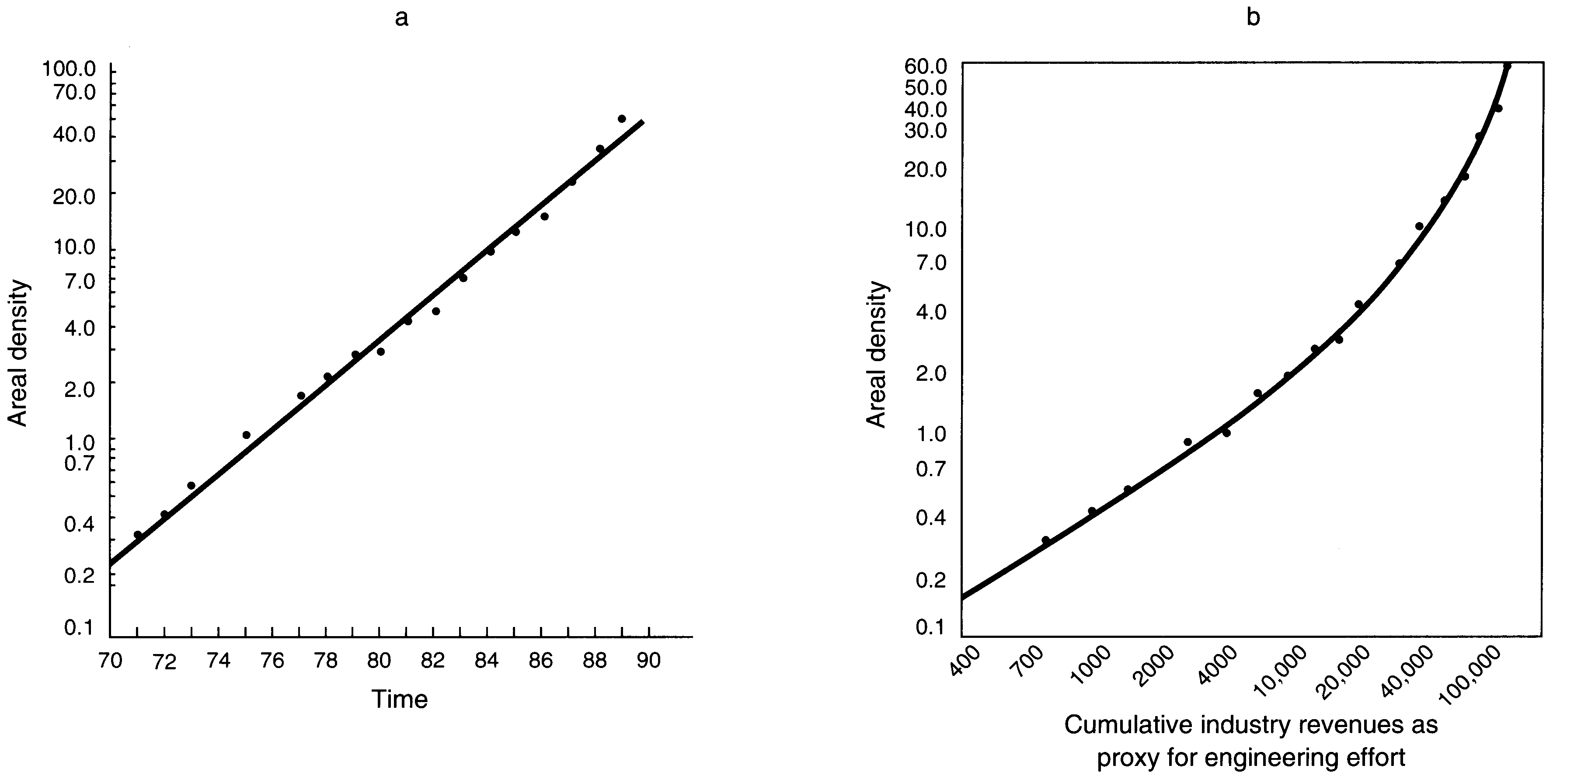
Magnetic Rigid Disk Drives
Hard Disk industry :
During 1970~1989, the improvement was steady, averaging 34% per year
With time as the horizontal metric, no S curve pattern of progress is yet apparent.
Measure total industry revenue as a proxy for engineering effort

Slide 19
Using S-Curve to Prescribe Development of New Component Technologies
The risk to switching to a new S-curve.
Cost more and take much longer time
When to manage the switch from one component technology to another?
Engineers sensed they were approaching the physical limit of ferrite cores before 1970.
With a process used in integrated circuit manufacturing, thin-film photolithography, they can create much smaller, more precise electromagnets on the head.

Slide 20
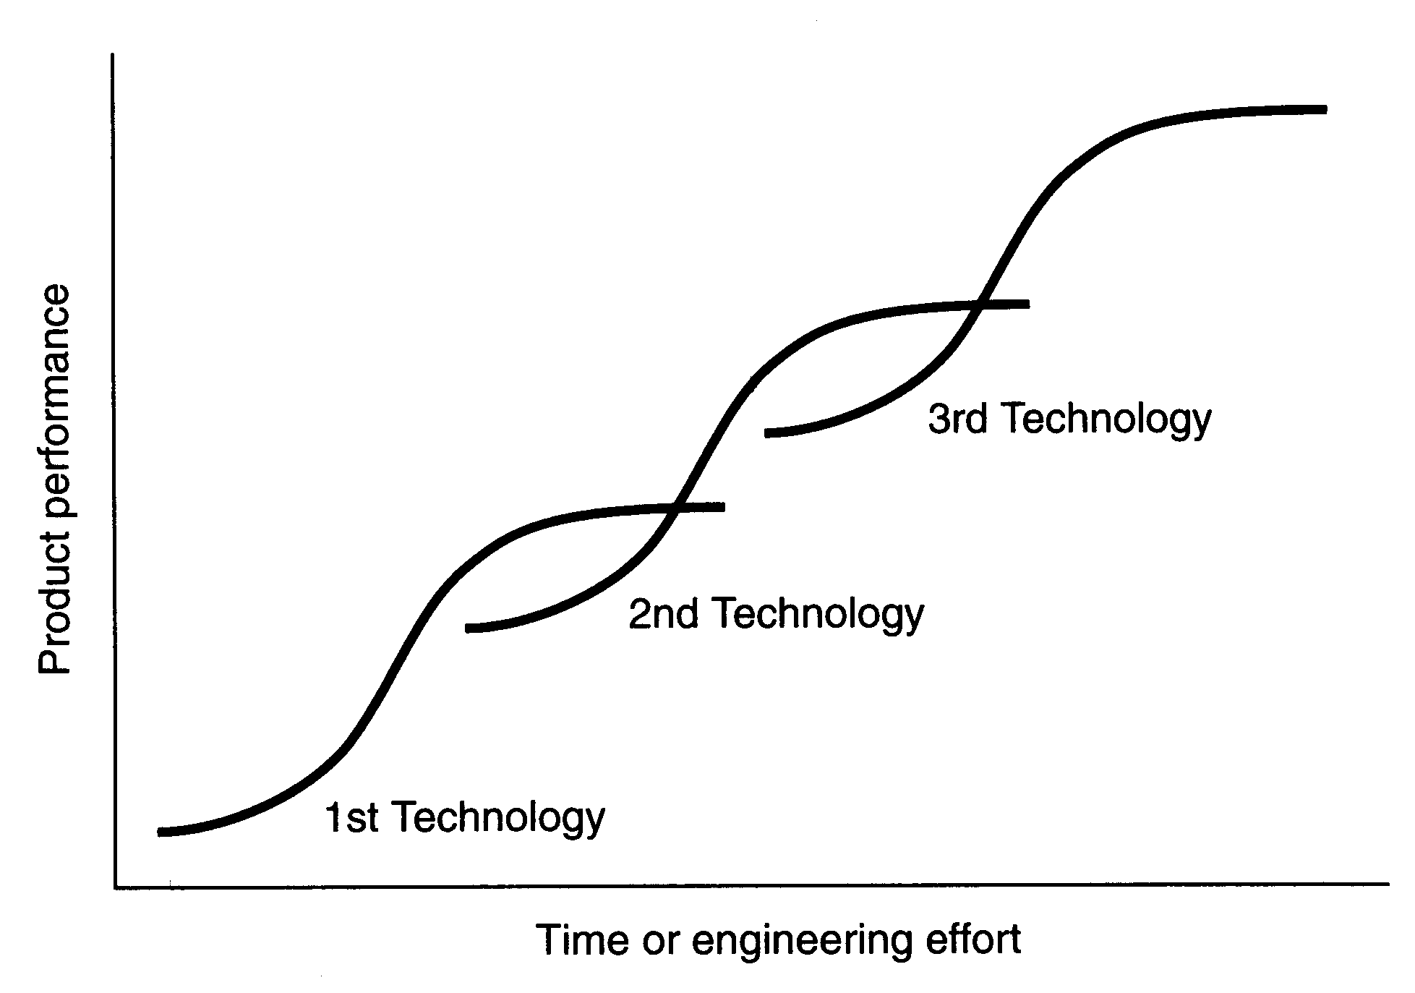
Comparing Prescriptive S-curve and S-curve of Architectural Innovation

Slide 21
The application of S-curve at a managerial level seems to be very ambiguous.
There is more than one way to skin the cat.
There was no clear evidence of any first mover benefits or “attackers’ advantage.”
Comparing with architectural technologies.
1. Switching to new component technology S-curve early results in no competitive advantage
2. Switching to architectural S-curve enjoys powerful first-mover advantage

Slide 22
Normal Technology Environment
Technology S-Curve
Private Equity
IPOs
Large Corporates
Commoditization of Technology
Technology maturity / market acceptance
Entrepreneurs
VC
Basic Research
Applied Research
Early
Mid
Late
Time

Slide 23
The “Gap”:
Research not linked to market
Little early-stage financing or services
Result: little commercialization
Private Equity
IPOs
Large Corporates
Commoditization of Technology
Technology maturity / market acceptance
Entrepreneurs
VC
Basic Research
Applied Research
Early
Mid
Late
Time

Slide 24
Diffusion of Technological Innovations
An innovation will spread quickly if it
Has a great advantage over its predecessor
Is compatible with existing systems, procedures, infrastructures, and ways of thinking
Has less rather than greater complexity
Can be tried and tested easily without significant cost or commitment
Can be observed and copied easily

Slide 25
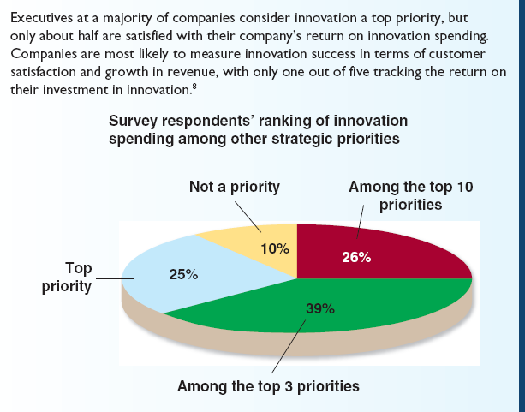
Technological Innovation in a Competitive Environment

Slide 26
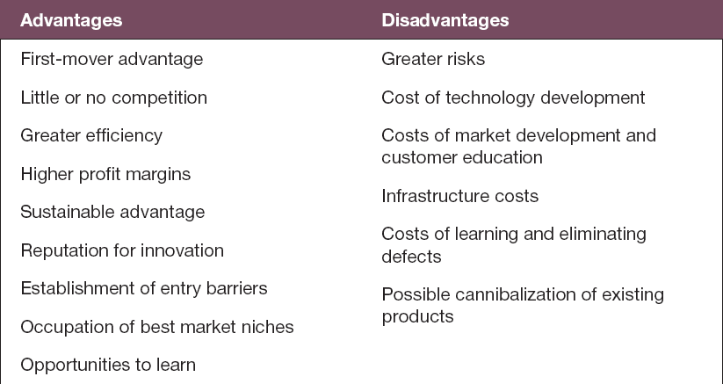
Advantages and Disadvantages of Technology Leadership

Slide 27
Technology Followership
A manager’s decision on when to adopt new technology also depends on the potential benefits of the new technology, as well as the organization’s technology skills
Following the technology leader can save development expense

Slide 28
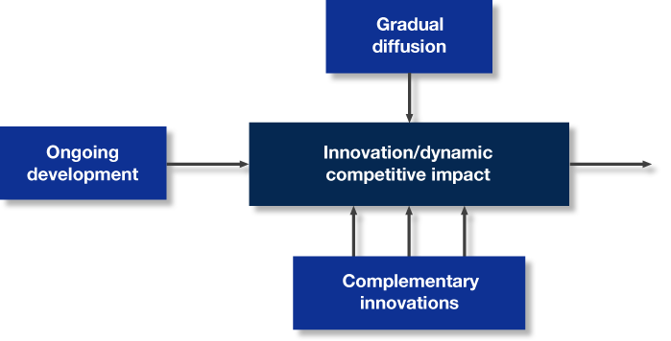
Dynamic Forces of a Technology’s Competitive Impact

Slide 29
Question
What is the process of clarifying the key technologies on which an organization depends?
Managerial audit
Benchmarking
External audit
Technology audit

Slide 30
Assessing Technology Needs
Technology audit
Process of clarifying the key technologies on which an organization depends

Slide 31
Measuring Current Technologies
Emerging technologies are still under development and thus are unproved
Pacing technologies have yet to prove their full value but have the potential to alter the rules of competition by providing significant advantage

Slide 32
Measuring Current Technologies
Key technologies have proved effective, but they also provide a strategic advantage because not everyone uses them
Base technologies are those that are commonplace in the industry; everyone must have them to be able to operate

Slide 33
Question
What is the process of comparing the organization’s practices and technologies with those of other companies?
Benchmarking
Quality control
Scanning
Environmental scanning

Slide 34

Assessing External Technological Trends
Benchmarking
the process of comparing the organization’s practices and technologies with those of other companies
17-

Slide 35
Assessing External Technological Trends
Scanning
focuses on what can be done and what is being developed
places greater emphasis on identifying and monitoring the sources of new technologies for an industry

Slide 36
Key Factors to Consider in Technology Decisions
Anticipated market receptiveness
Technology feasibility
Economic viability
Anticipated competency development
Organizational suitability
17-

Slide 37
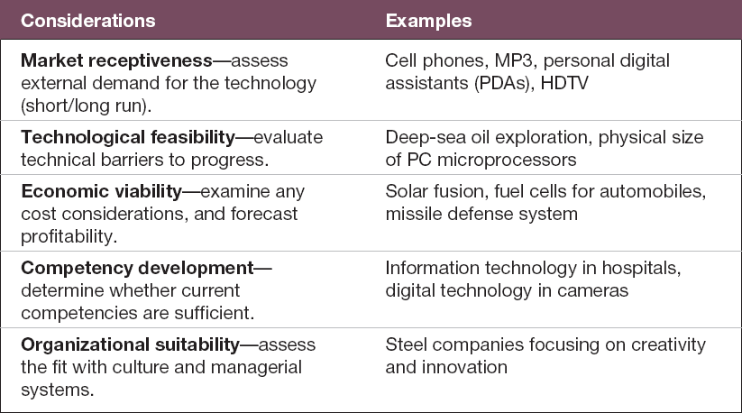
Framing Decisions about Technological Innovation

Slide 38
Sourcing and Acquiring New Technologies
Make-or-buy decision
The question an organization asks itself about whether to acquire new technology from an outside source or develop it itself.

Slide 39
Sourcing and Acquiring New Technologies
Internal development
Purchase
Contracted development
Licensing
Technology trading
Research partnerships and joint ventures
Acquisition of the owner of the technology

Slide 40
Sourcing and Acquiring New Technologies
Managers should ask the following basic questions:
Is it important (and possible) in terms of competitive advantage that the technology remain proprietary?
Are the time, skills, and resources for internal development available?
Is the technology readily available outside the company?

Slide 41
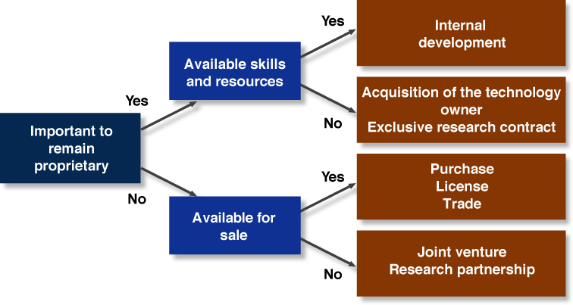
Technology Acquisition Options

Slide 42
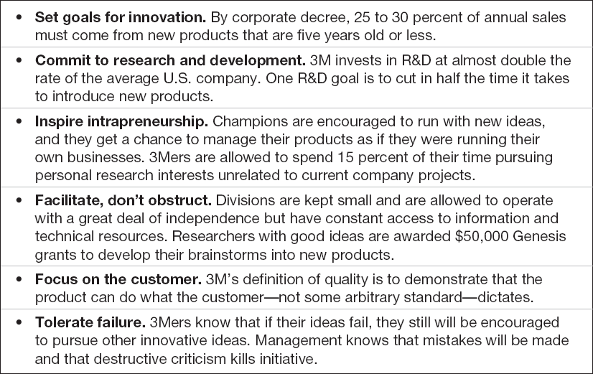
3M’s Rules for an Innovative Culture

Slide 43
Example: Technology development drives product innovation

Slide 44
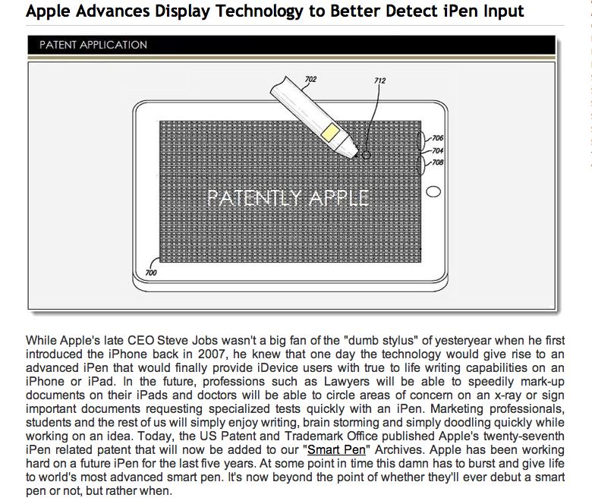

Slide 45
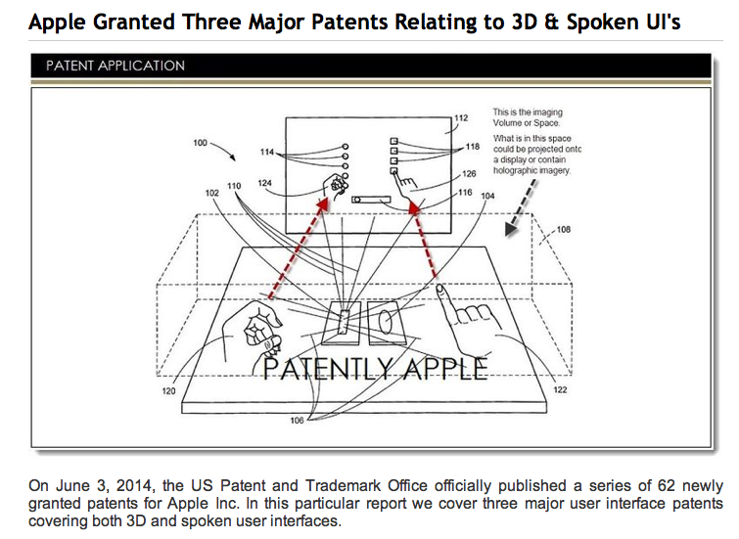

Slide 46
Who should manage this journey of creating wealth out of technology innovation in open market economy?
Should engineers do this job? Who can do this job better than engineers?

